Slide 1



Phonics
Read Write Inc

Slide 2

What is phonics?
Phonics is the building blocks of reading and writing.
matching letters to sounds (to read)
matching sounds to letters (to write)
letter sounds not names
26 letters/44 sounds
letter combinations ‘special friends’
use pure sounds, e.g. mmm not muh, sss not suh (using pure sounds makes it easier to blend)
blending sounds to read
Segmenting sounds to spell

Slide 3

How is phonics taught at Mereside?
daily adult led learning
children are grouped according to the next step in their learning
pupils who need additional support are identified

Slide 4

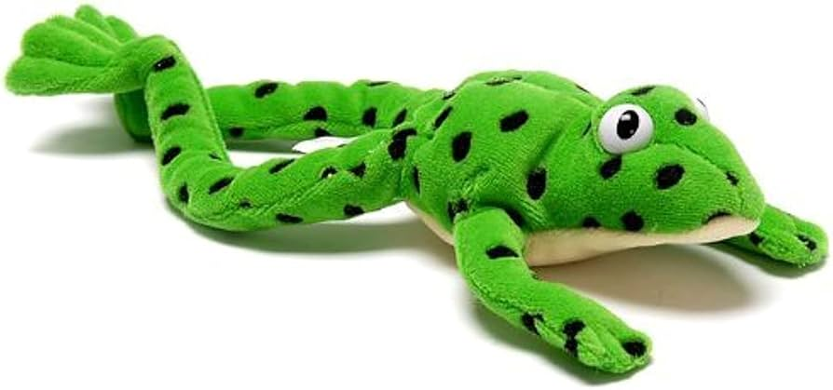
What happens in a phonic session?
new sounds taught
write the letter
oral blending
review sounds
read the words
write the words
ditty/story books
Fred talk

Slide 5
What is oral blending?
oral blending is when children can HEAR the individual sounds
they push the sounds together to form the whole word
adult ‘Fred talks’ the word and children orally blend
play games like Simon Says/I Spy
Fred talk instructions, e.g. get your c-oa-t

Slide 6
What is blending to read?
When children move onto blending written letters it requires lots of skills all at same time
children need to be able quickly identify letters (or combinations of letters
the sounds the letters make
remember them in order
merge the sounds together
cat shop

Slide 7
How can I help my child to learn sounds
repetition
routine
games
pointing them out in environment
use reading record

Slide 8

How can I help my child to blend?
oral blending activities
increase confidence matching letters with sounds
word families, e.g. cat bat hat…
vowel consonant words, e.g. am, if,
continuous consonants sssss mmm rather than short sounds like p d g
add sound buttons
develop auditory and visual memory

Slide 9
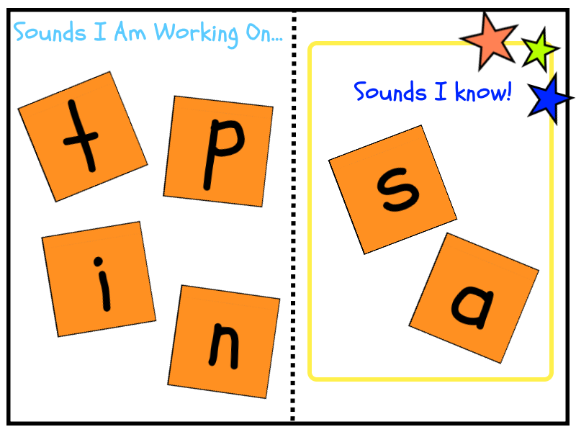
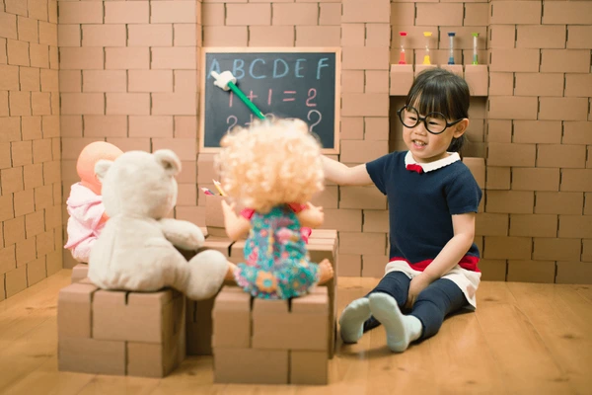

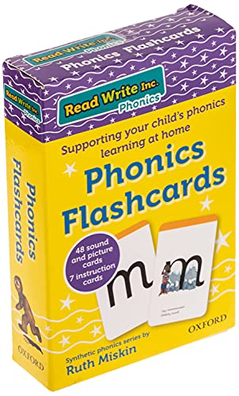
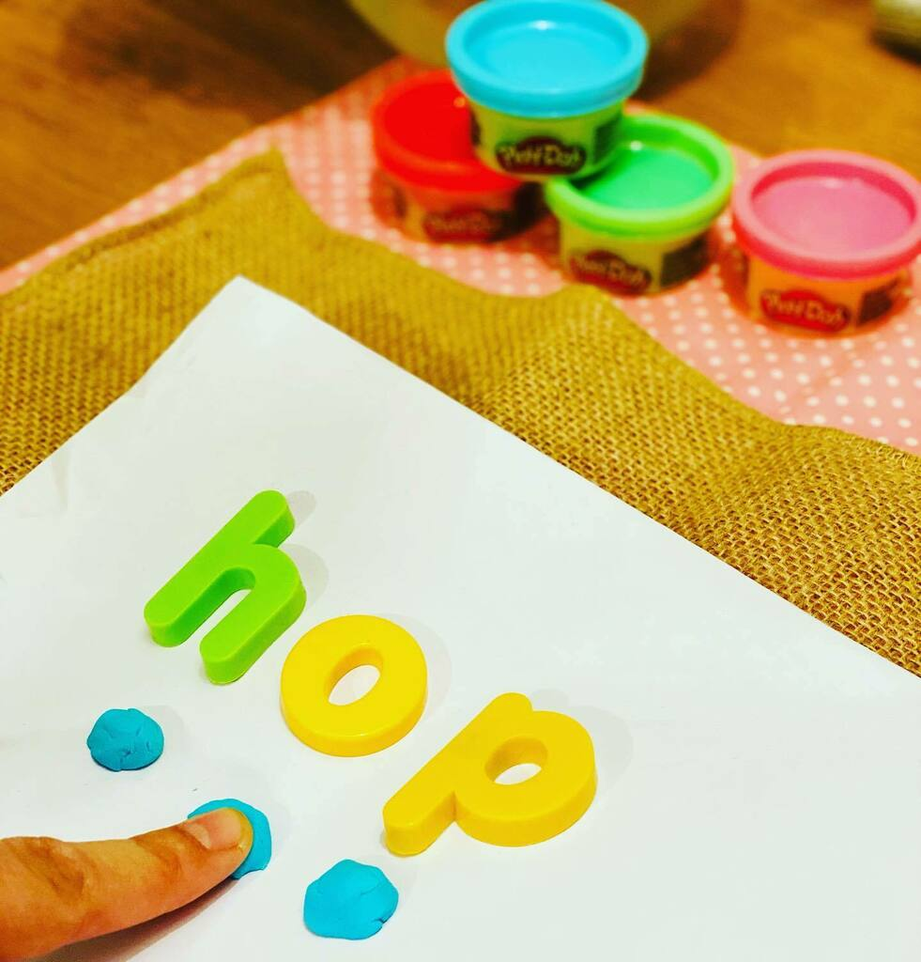
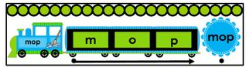
Activities

Slide 10
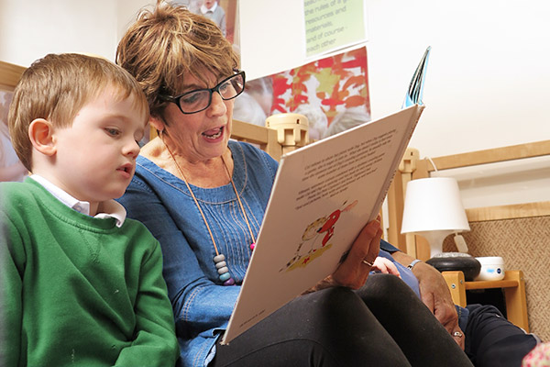

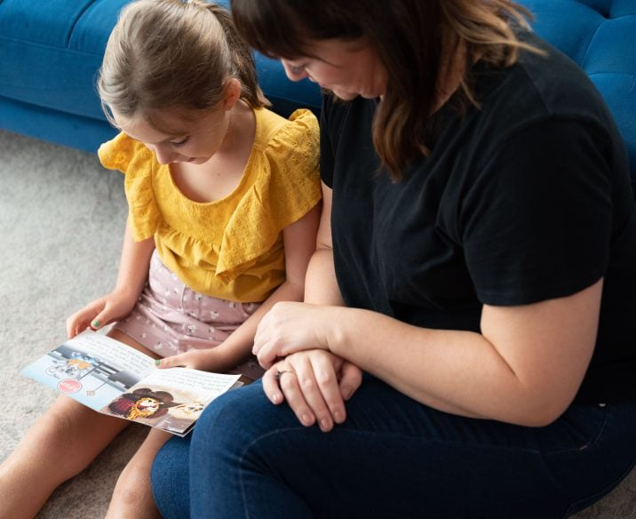
Reading Activities
adult reading to a child
adult and child reading together
child reading to the adult

Slide 11

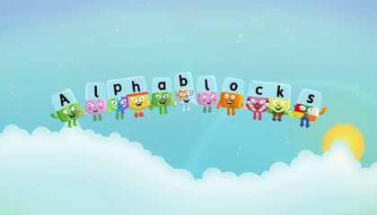
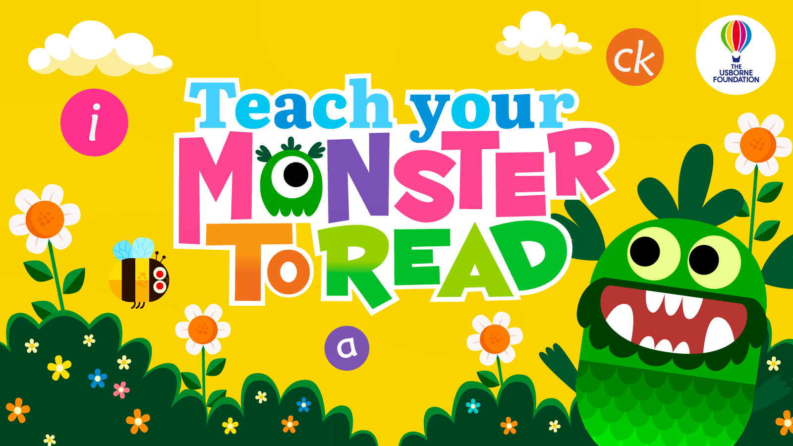
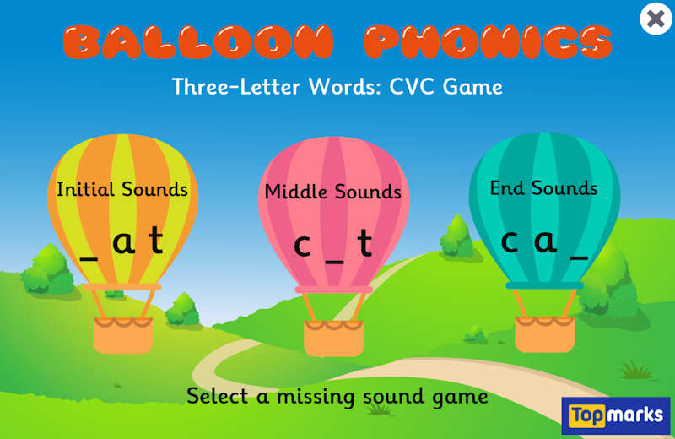
Screen Time Activities
*children should always be accompanied by an adult when
they have screen time

Slide 12
What are the next steps in reading once my child can blend?
special friends
syllables/beats in polysyllabic words
reading captions and sentences
blending in head ‘Fred in your head’

Slide 13

Red words
high frequency words that cannot yet be read or spelt using phonics
identify ‘tricky sounds’ within words
repetition helps learning
the I no he my
T: 01743 356283 | E: admin@mereside.shropshire.sch.uk | W: meresideacademy.org.uk

Slide 14

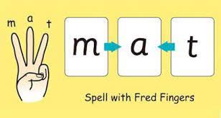

Spelling words
saying the words and listening for sounds
identifying sounds in order
matching sounds with letters
forming letters
writing from left to right
.
T: 01743 356283 | E: admin@mereside.shropshire.sch.uk | W: meresideacademy.org.uk

