Slide 1



Starting School
June 2026

Slide 2


Introductions
Our School
Starting School

Slide 3
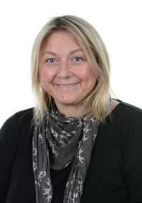
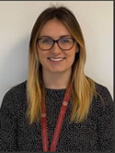
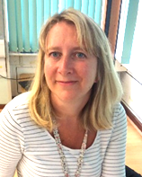
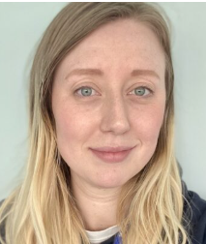
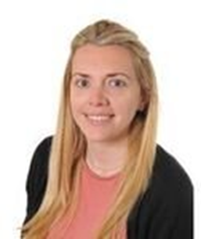
Staff
Linsey Hughes
Headteacher
Beth Bryant
SENDCo
Rachel Harper
Wrens Teacher
EYFS Lead
Lucy Johnston
Wrens Teacher
Rachel Wakefield
Robins Teacher

Slide 4

Our School
Love to Learn
Learn to Love

Slide 5
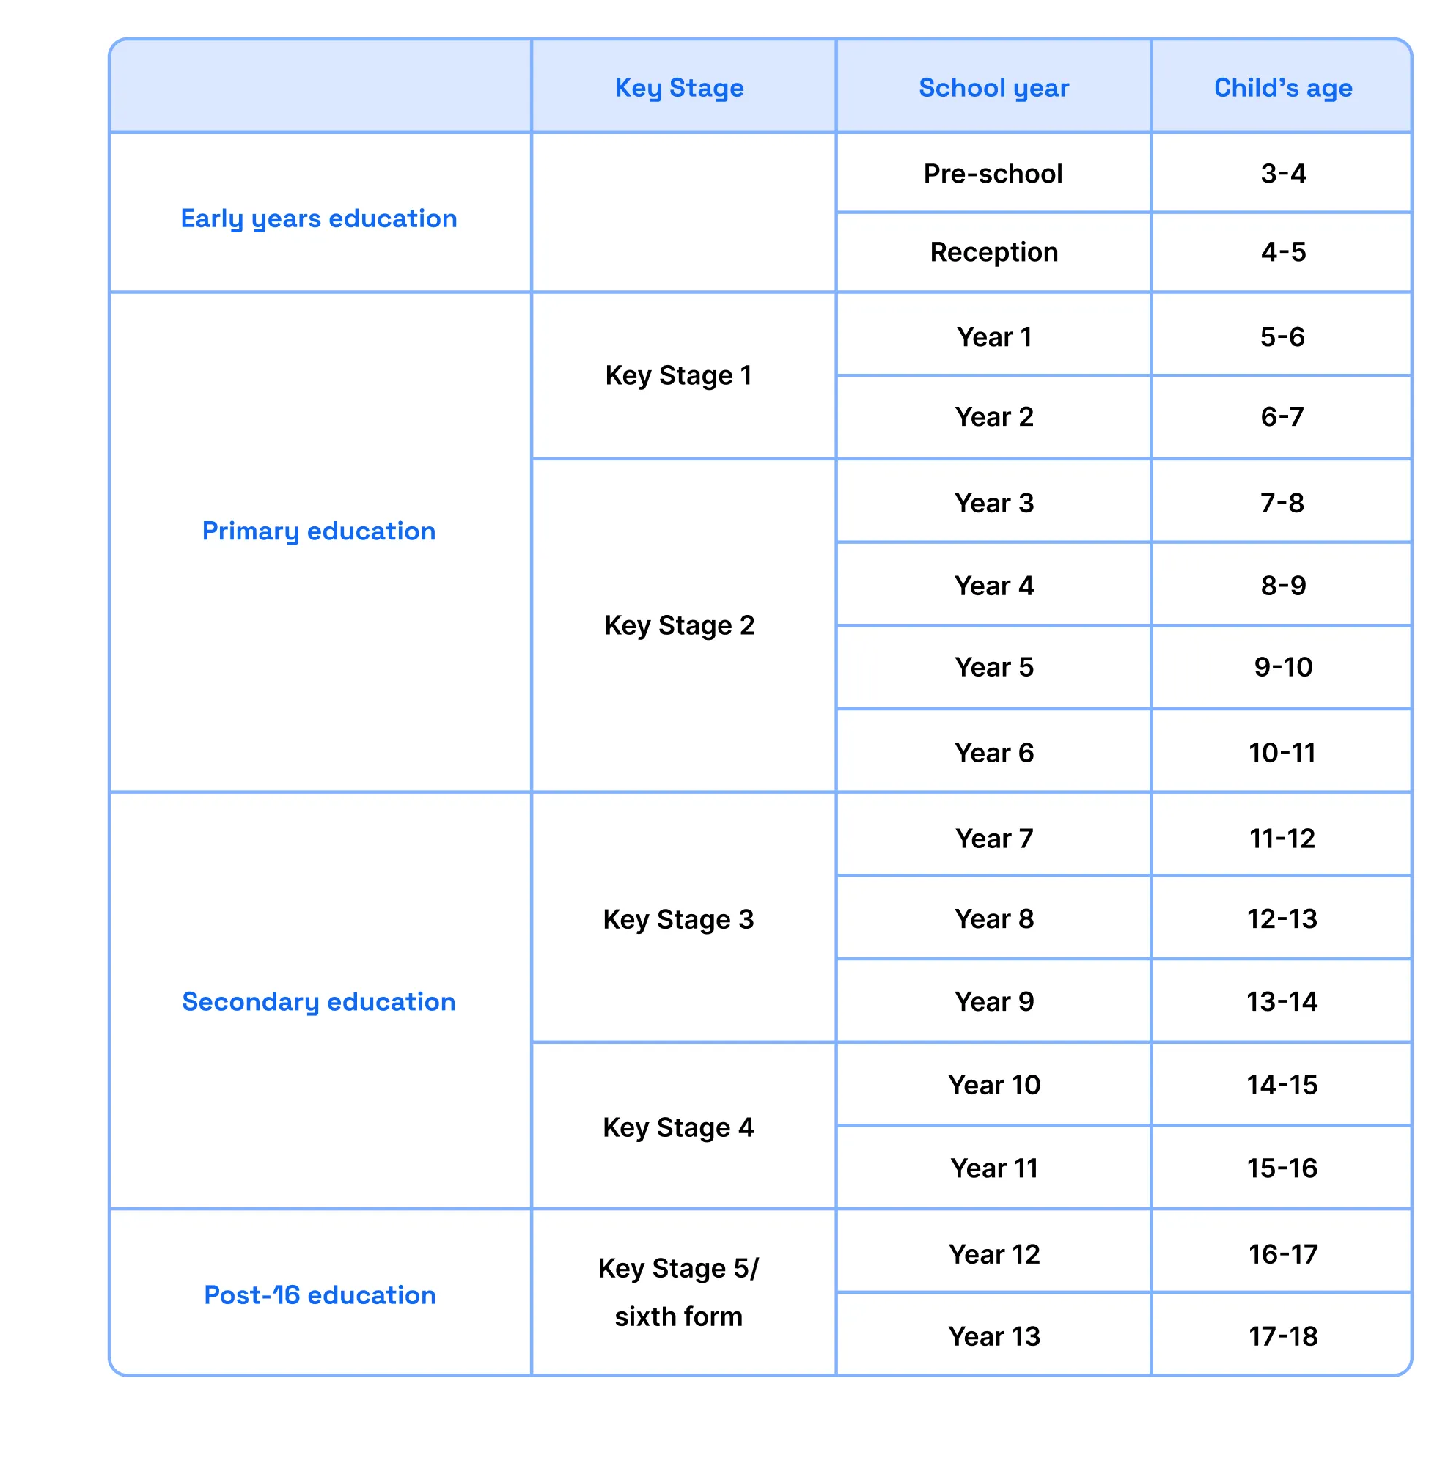
Mereside CE Primary Academy

Slide 6

Thursday 3rd September
Autumn term begins
The School Day
*If you are unable to pick up, please let the class teacher know to expect someone different and provide us with the name and a password
*Wrap around care is available on site at Treetops but must be booked in advance
morning | 8.40 (till 8.50) | gates open for drop off
afternoon | 3.10 | gates open for pick up

Slide 7
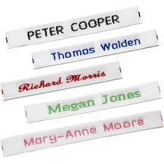


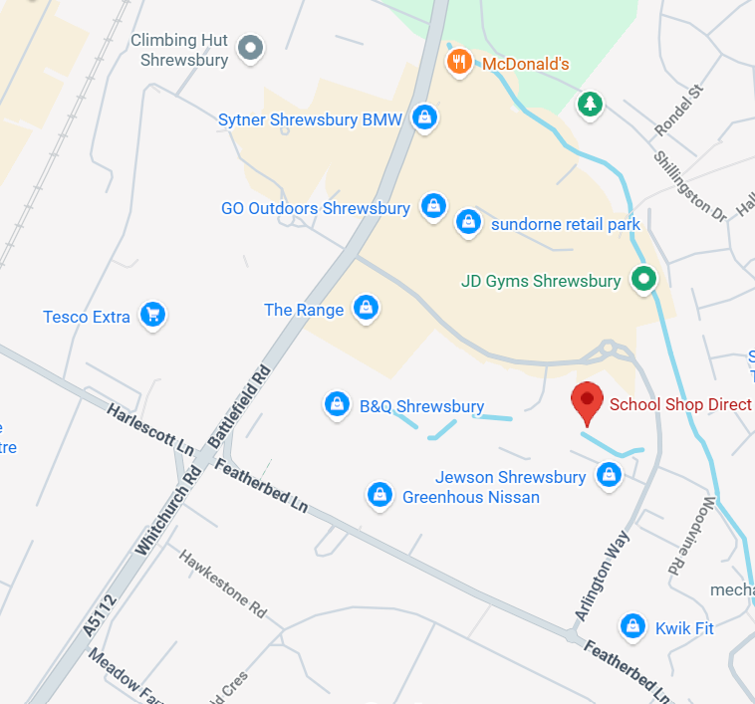
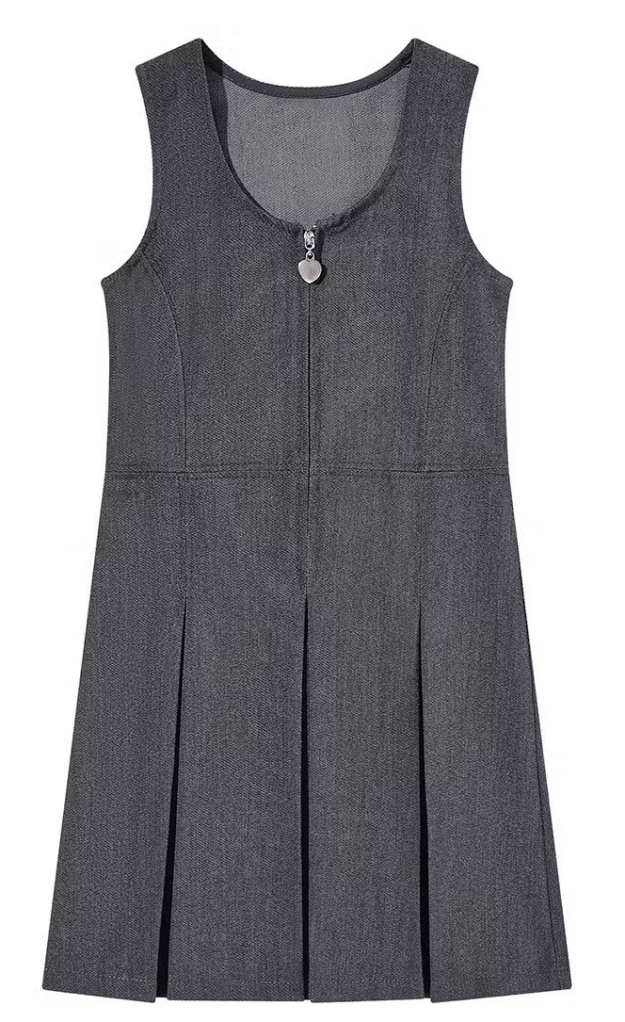
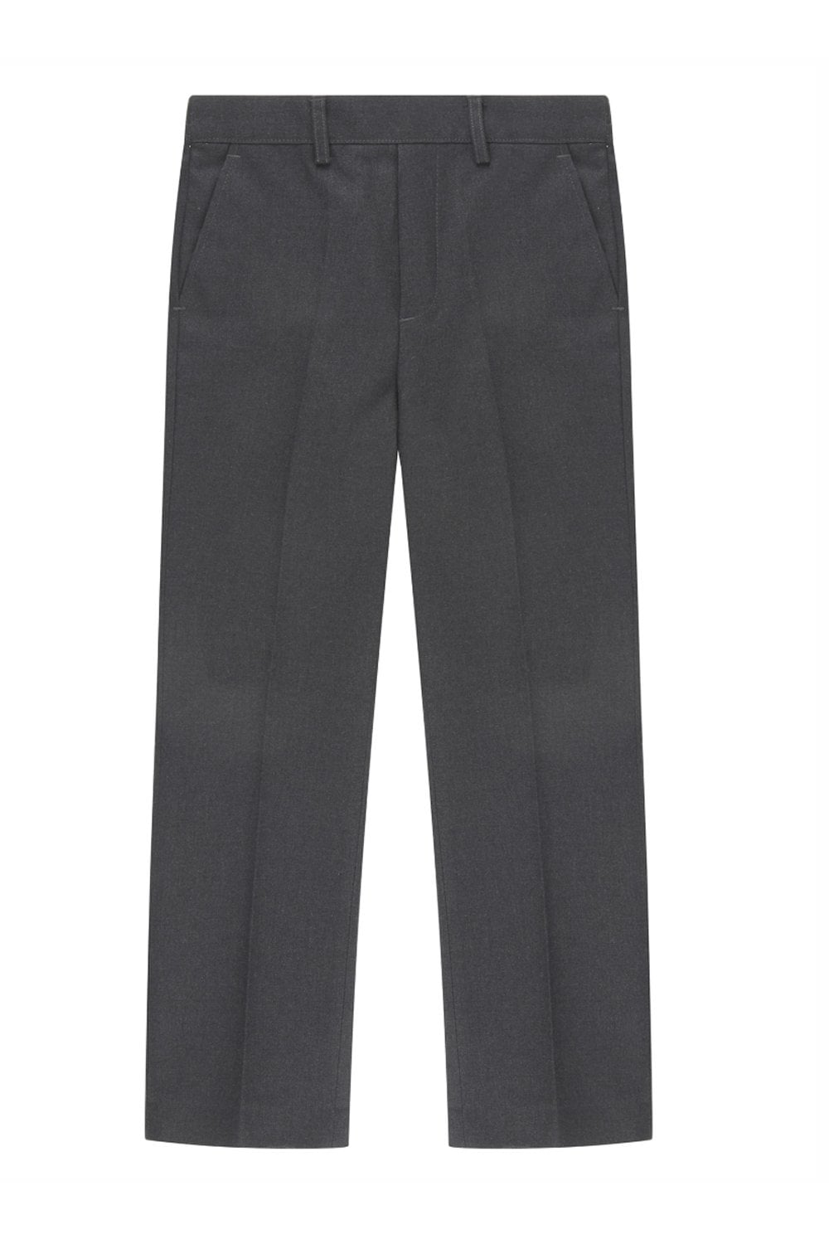

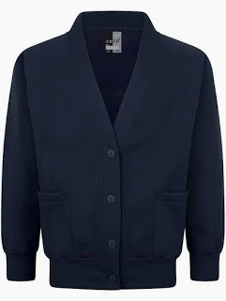
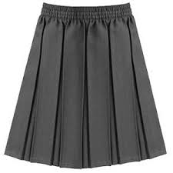
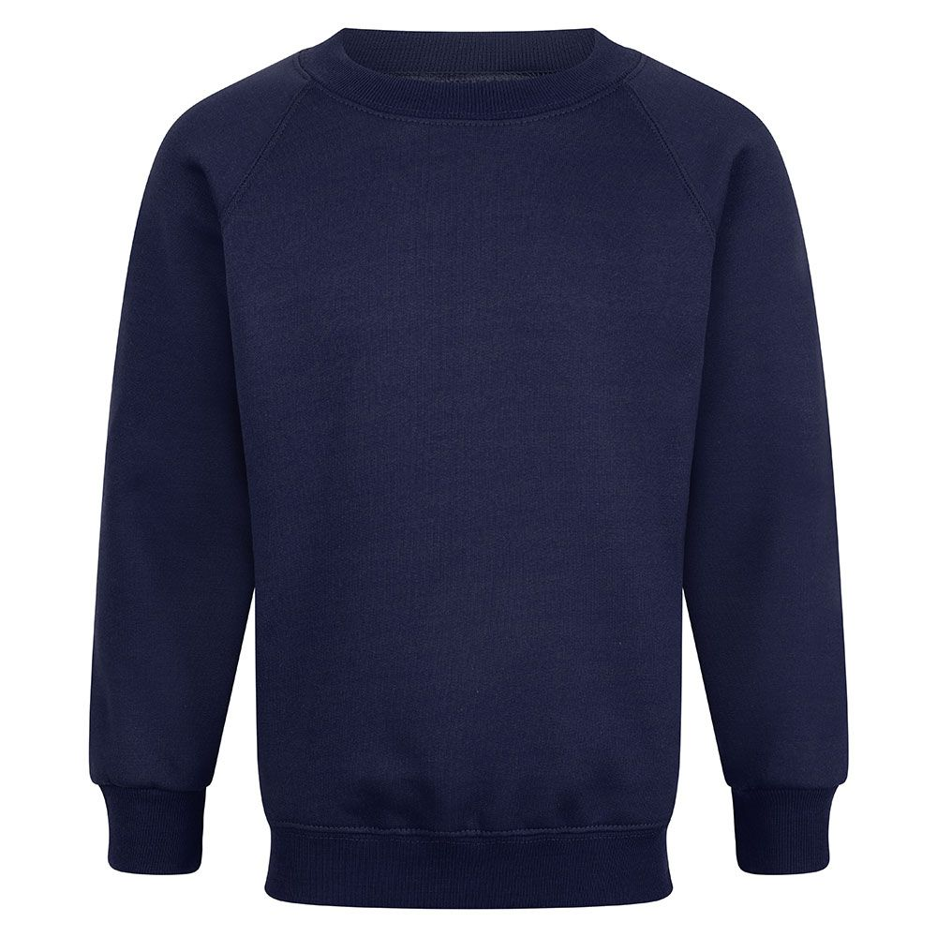
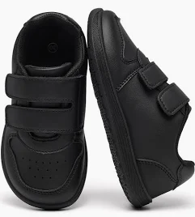
Uniform
Uniform can be bought from most supermarkets and department stores
The Friends of Mereside (PTA) has good quality second hand uniform
Items with the Mereside logo can be bought from School Shop Direct in Sundorne
Please label everything, including coats, shoes, hats etc
PE kit is not required until the Summer Term. We will contact you before then to give you information about the kit your child will need.

Slide 8
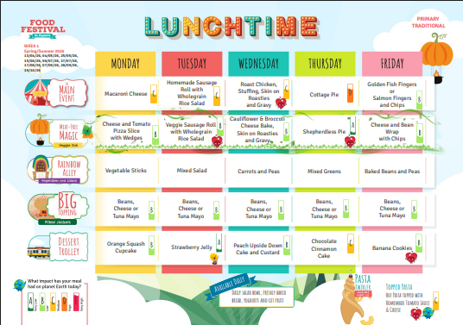
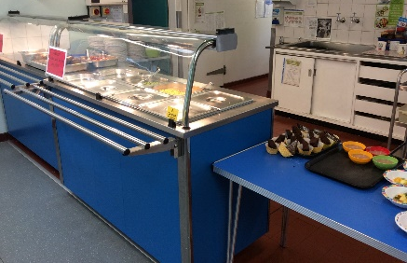
Lunches
School meals help encourage good eating habits from an early age and provide the opportunity to further develop their social skills as they sit down with friends to enjoy their meal
All Key Stage One children; Reception, year one and two, are provided with a free school meal. Some children are entitled to free school meals throughout their education (FSM).
There is a meat based meal, a vegetarian option and a filled baked potato available every day.
If your child has a food allergy or any dietary requirements please let the school know as soon as possible.
You will be provided with a copy of the menu so that you can help your child choose before they come to school. Children record their choices on the smart board as they come in every morning.
Alternatively, children can bring a healthy packed lunch from home

Slide 9

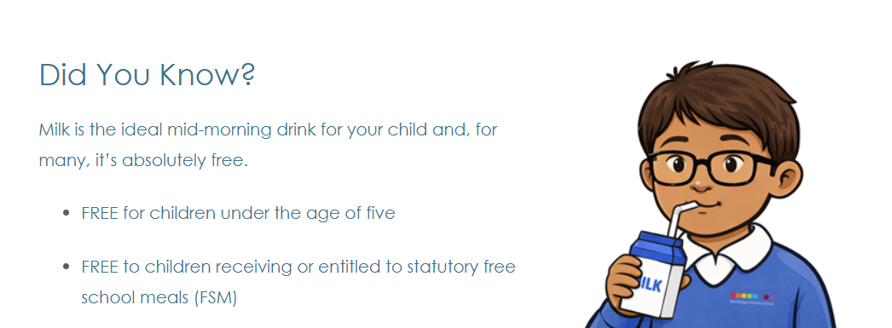
Milk and Snack
All our reception children can have a bottle of milk for their morning drink. It is free until your child’s fifth birthday after which there is a cost. A booking form can be found in your information pack.
It is free throughout Primary School if your child is entitled to free school meals (FSM).
Please only choose milk for your child if they are happy to drink it at home!
All children need to bring a water bottle whether or not they choose to have milk.
A free fruit/vegetable snack is also provided every day.

Slide 10
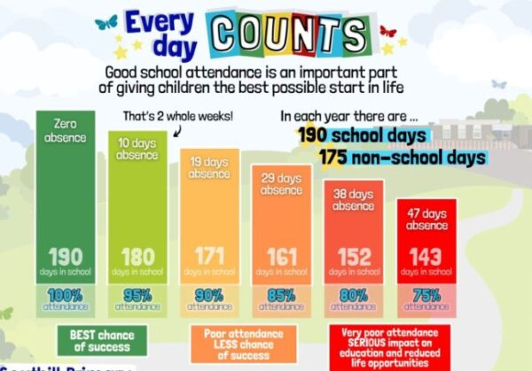
Attendance
“Education is the passport to the future, and attendance is the stamp that gets you there.”
Parents must inform the school of a reason for absence before 9.30am to prevent the absence being recorded as unauthorised.
School attendance is monitored by the Head of School, Attendance
Officer (Mrs Ackers) and the Local Authority, in accordance with the
Education Attendance Regulations.
Punctuality is important both for the child and the teacher. Please
ensure that your child arrives at school at 8.40am as the gated open.
A child arriving at school after this time will be recorded as late.

Slide 11
Starting School

Slide 12
Reception Year
The Early Years Foundation Stage (E.Y.F.S.) is the stage of education for children from birth to the end of the reception year.
Your child is about to begin their final year in this stage of their learning.
It is based on the recognition that children learn best through play and active learning.
Your child will learn through a balance of Adult Led and Child Initiated learning.

Slide 13

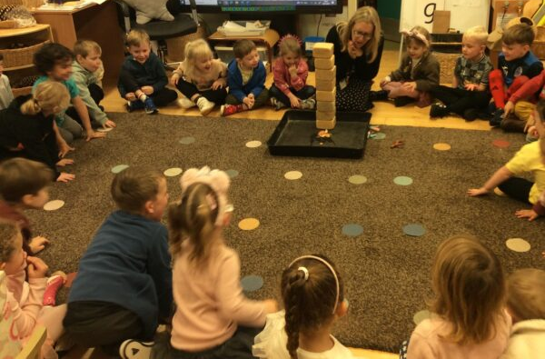
Adult Led/Adult Initiated Learning
Regular, short sessions
Led by class teacher or teaching assistant
Focuses on teaching new skills and knowledge
Child Initiated Learning
Initiated by child
Learning through play
Based on child’s own experiences and interests
Opportunity to apply learning
Opportunity for adults to enhance learning through high quality interactions
= high levels of engagement

Slide 14


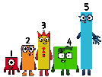

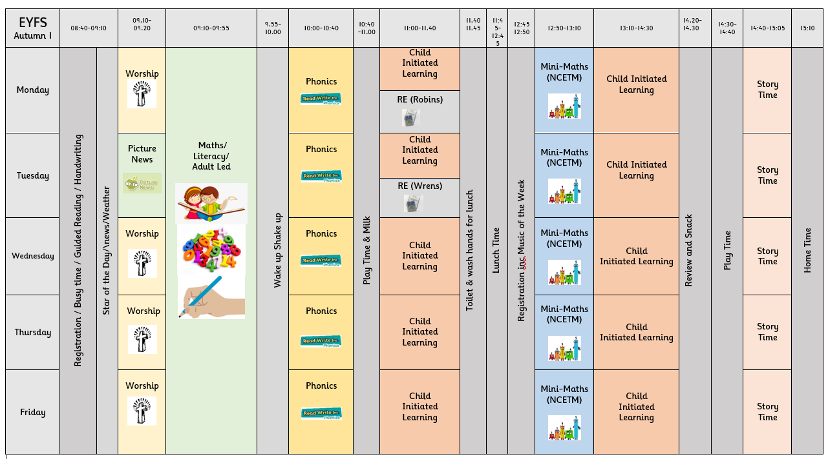

Slide 15
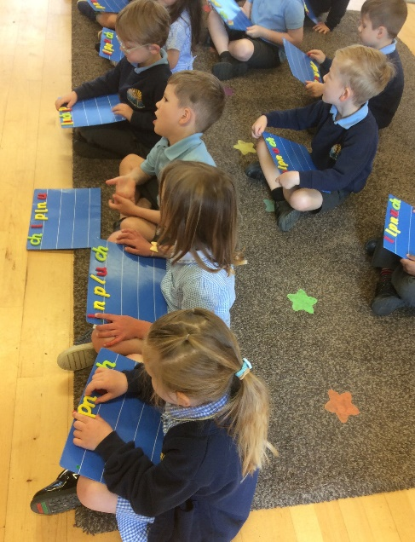
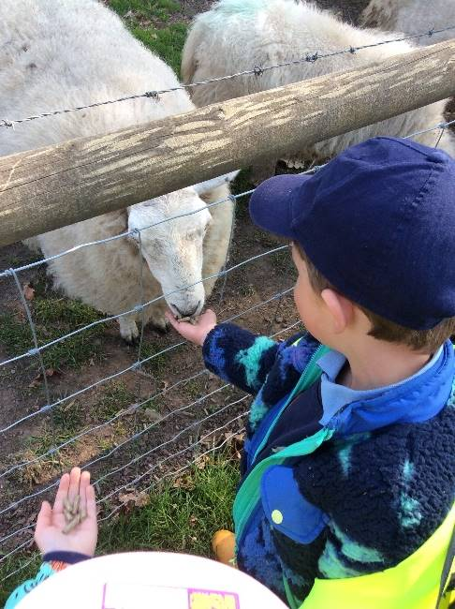
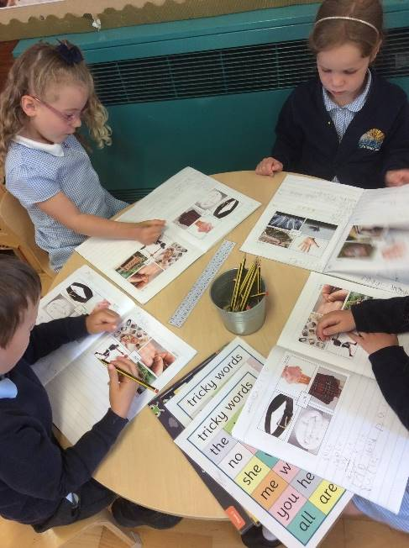
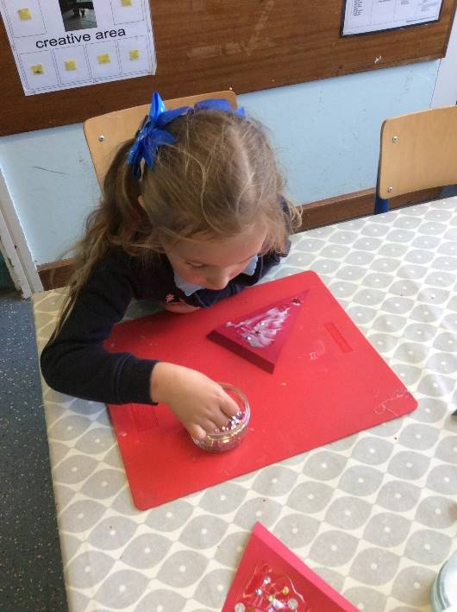
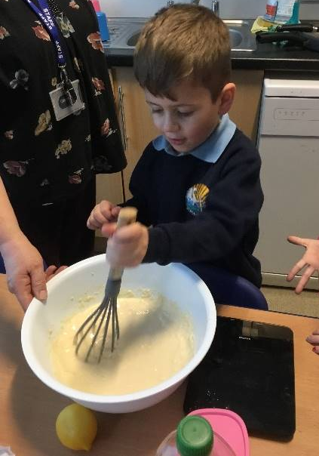
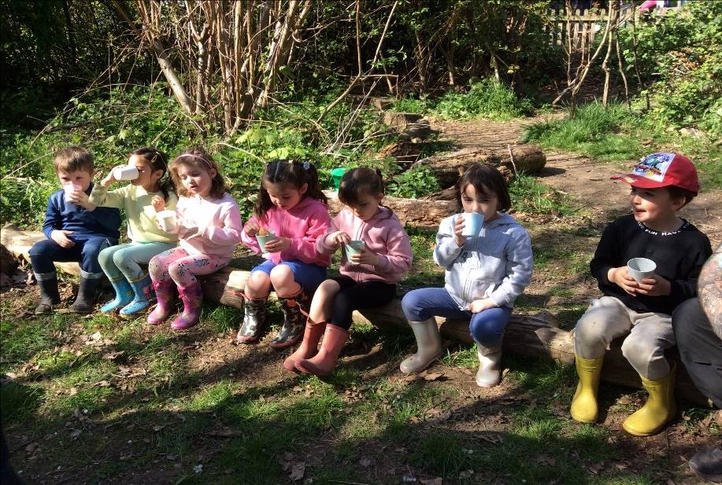
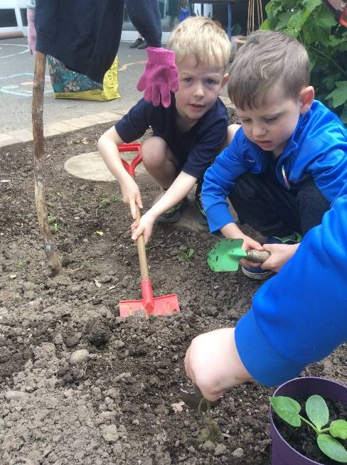
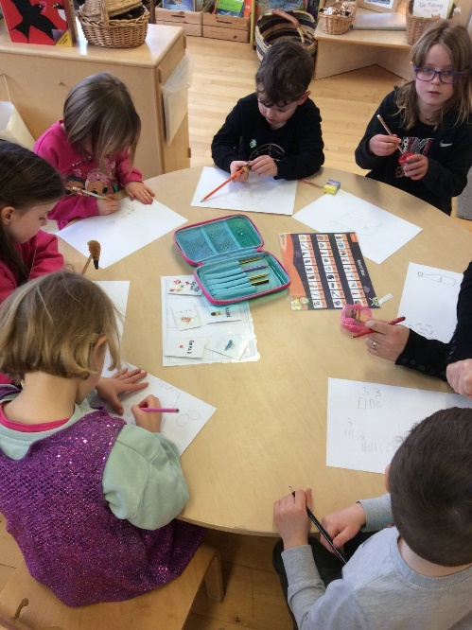
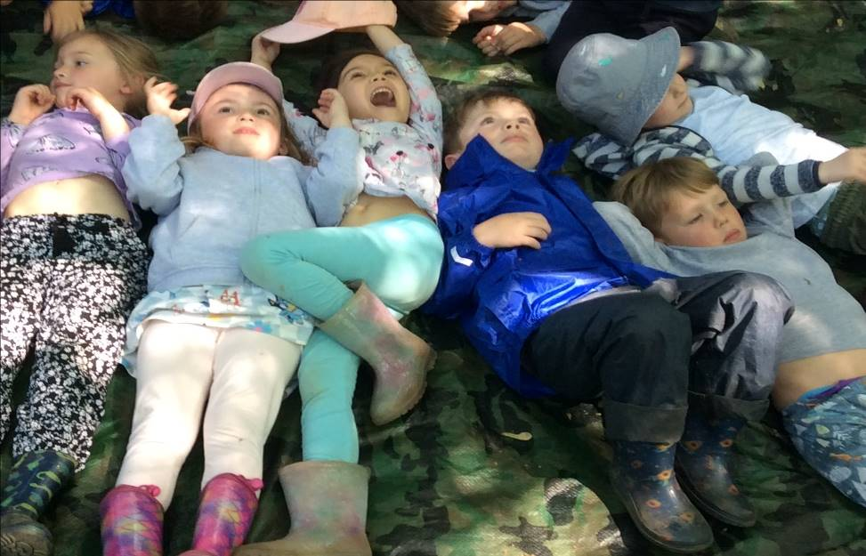

Slide 16
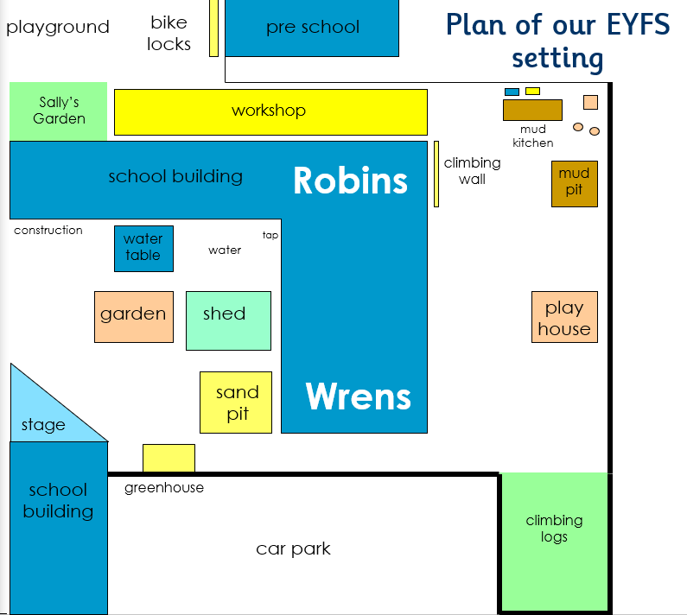

Slide 17
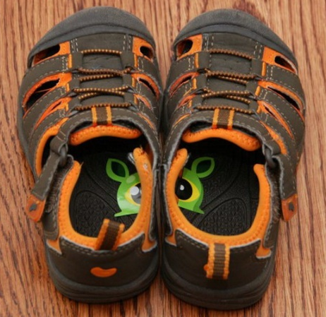

School Readiness
Building Relationships Practise saying hello, good morning, please and thank you Greet friends and family with a friendly smile Create games and activities where there are opportunities to share and take turns Invite friends for play dates Play with your child, modelling friendly behaviour | Being Independent Practise putting coats, shoes, jumpers and cardigans on and off independently Show your child their name labels to help them recognise their belongings Familiarise children with their coat, bag, uniform and water bottle Practise using water bottle Encourage your child to go to the toilet wipe themselves and wash/dry their hands Practise using cutlery and carrying a tray | Making Choices Create opportunities for your child to make a choice…and stick to it, e.g. choosing breakfast, story time book, what to wear
Managing Feelings Encourage your child to talk about their feelings using the words happy, sad, angry and wobbly Talk about the feelings of the characters in the stories you read Talk to your child about ways to cope with feelings when things go wrong Give your child opportunities to practice waiting | Speaking and Listening Ask your child to be still and look at the person who is talking Encourage your child to use words to communicate their needs, e.g. I need the toilet Introduce them to new vocabulary e.g. their teachers’ name, classroom, tray, peg. Lots and lots of conversation and story reading | Familiarity Attend as many of the school sessions as you can Book a home visit Take regular walks past the school Begin to talk about and create new routines ready for school Come to the school fair on Saturday 4th July

Slide 18
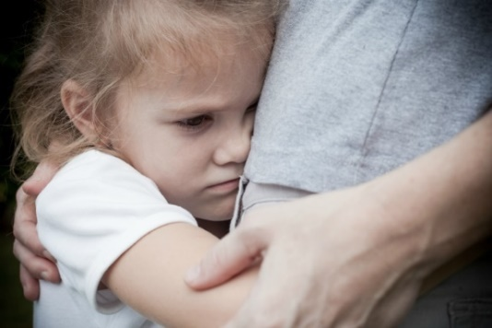
Separation Anxiety
Acknowledge your child’s feelings if they are finding it hard to say goodbye.
Give yourselves plenty of time for getting ready for school.
Have a quick, positive, drop off ritual with a clear goodbye that your child definitely hears. Don’t be tempted to sneak out.
Make sure your child knows who is picking up at the end of the day.
Once your child has had a chance to familiarise themselves with the adults, their friends or an activity make your exit-don’t linger!
Children settle very quickly into the school day. If you would like reassurance that all is okay, don’t hesitate to ring school or message on Dojo us to check.

Slide 19
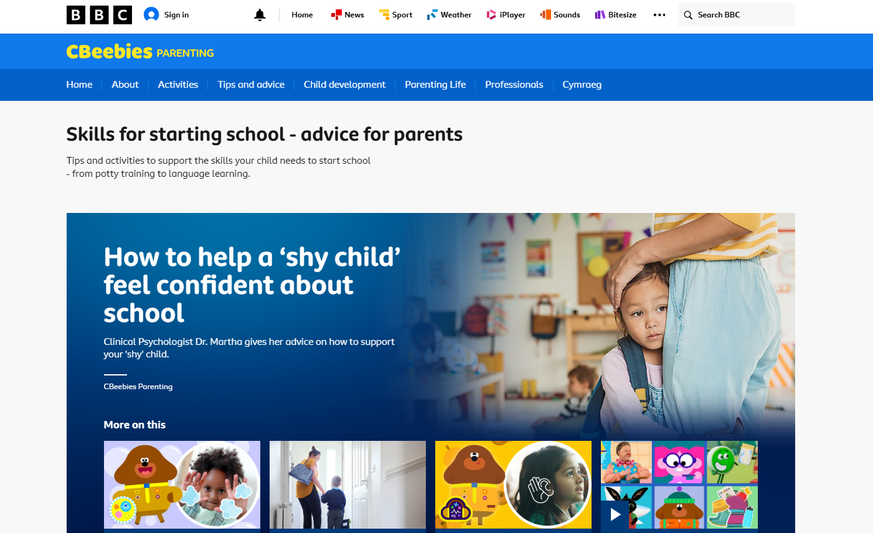

Slide 20
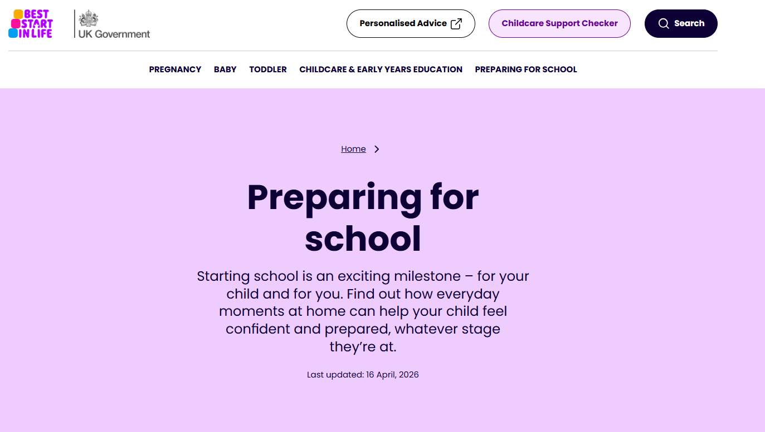

Slide 21
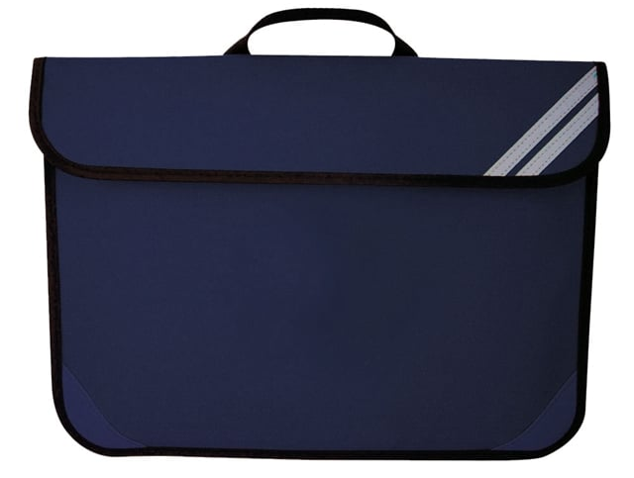
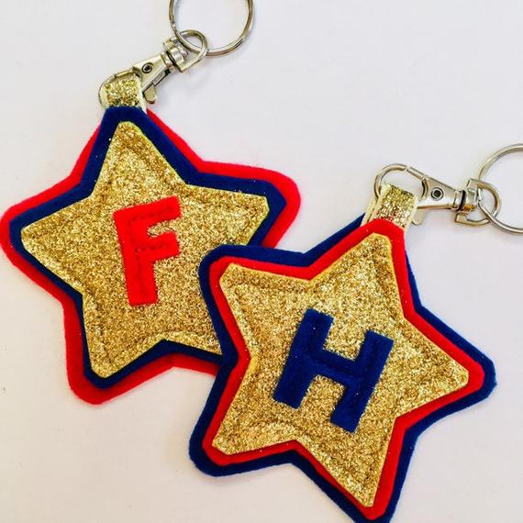
What does my child need to bring to school?
Yes | No
*Coat (whatever the weather) *A water bottle *A book bag or other small bag | *Toys (apart from the first day or two to help them settle in) *Squash/juice
Please make sure EVERYTHING, uniform, coats, shoes, water bottles bags, are clearly labelled
Please don’t send children in shoes or trainers with laces until they can do them independently.
Consider using keyrings, book charms etc, on bags to help children quickly
identify which book bag is theirs.

Slide 22
What happens next?
May |  | Pre-school visits
Wednesday 3rd June | 2-2.45pm | Parent Information session
June |  | Home Visits
Tuesday 25th June | 4-5pm | Family School Visit
Tuesday 30th June | 1.30-2.30pm | Stay and Play Afternoon Tea
Thursday 2nd July | 1.30-2.30pm | Stay and Play
Thursday 7th July | 9.30-10.30pm | Stay and Play
Thursday 3rd September |  | Autumn term begins
Our SENDCO, Mrs Bryant will be available to meet with parents at these sessions
Representatives form the PTA will attend the Family School visit and the afternoon tea

Slide 23


Slide 24

What happens next?

Slide 25
Home Visits
Wrens Mrs Harper | Robins Mrs Wakefield
tbc | Tuesday 9th June
 | Friday 19th June
Sign up if you would like a home visit and we will contact you with available dates | Sign up with Mrs Wakefield
Morning visits will be between 9-12
Afternoon visits will be between 1 and 3

Slide 26
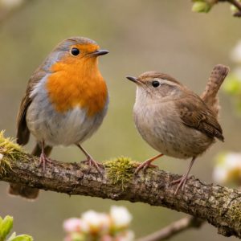
Please return forms from information pack as soon as possible

